Slide 1



QAI Token EVCI Use Case
WHITE PAPER 2025

Slide 2


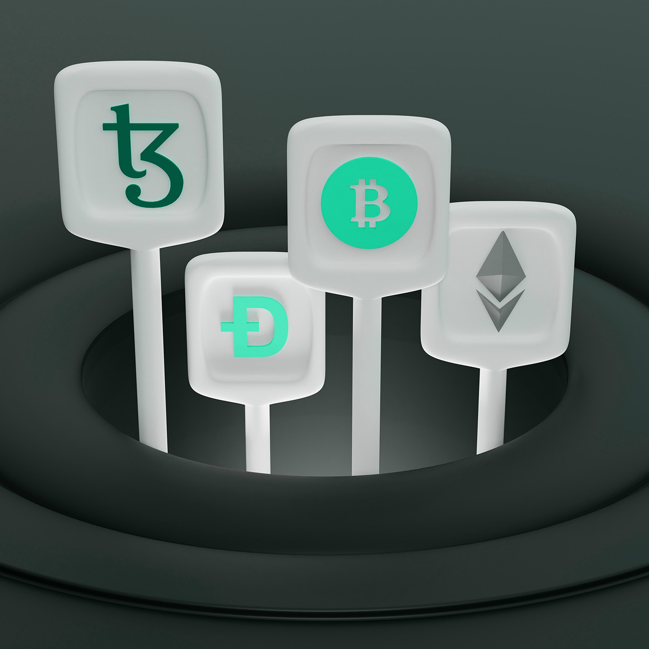
Introduction
Electric vehicle (EV) owners lead our greener future.
Standard charging networks can be clunky, pricey, and not secure enough.
The QuantumAI Token (QAI) aims to fix this using a decentralized blockchain network and AI tools, all wrapped in quantum-resistant security.
EV owners can pay with QAI tokens or credit/debit.
Our system focuses on privacy-first payments. That means less user data collected and stronger safeguards.
Key Goal
Offer a simpler, cost-saving, and privacy-friendly path for EV charging.
Unique Twist
We run pilot tests first. Then we grow as we learn what works.

Slide 3


Vision and Mission
HCISS, LLC (BSECAENERGY) imagines a world where QAI powers a safer, greener EV charging scene. By 2028, we want top-notch security and sustainability in e-mobility.
Our mission is to speed up EV adoption. We deliver advanced yet careful AI and Quantum solutions. We also respect user data. We want to support people in many cultures who seek clean energy and trust.

Slide 4




QAI Token EVCI Strategy
Blockchain Security
Pilot AI and Quantum Carefully
Focus on Privacy and Control
Tamper-proof storage and identity tracking.
Minimal user data.
AI helps with real-time adjustments. It balances energy demand.
Quantum-resistant cryptography adds an extra layer
We only gather data needed for billing or rewards.
Clear settings for users’ comfort.

Slide 5


Strategy
01
02
03
Blockchain Security
Pilot AI and Quantum Carefully
Focus on Privacy and Control
We use tamper-proof storage and identity tracking.
We keep user data minimal, so your info is safe.
AI helps with real-time adjustments. It balances energy demand.
Quantum-resistant cryptography adds an extra layer.
We test both in small steps before going big.
We only gather data needed for billing or rewards.
We provide clear settings, so users feel comfortable.

Slide 6
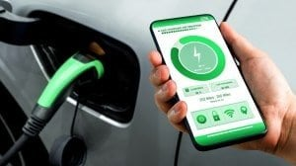

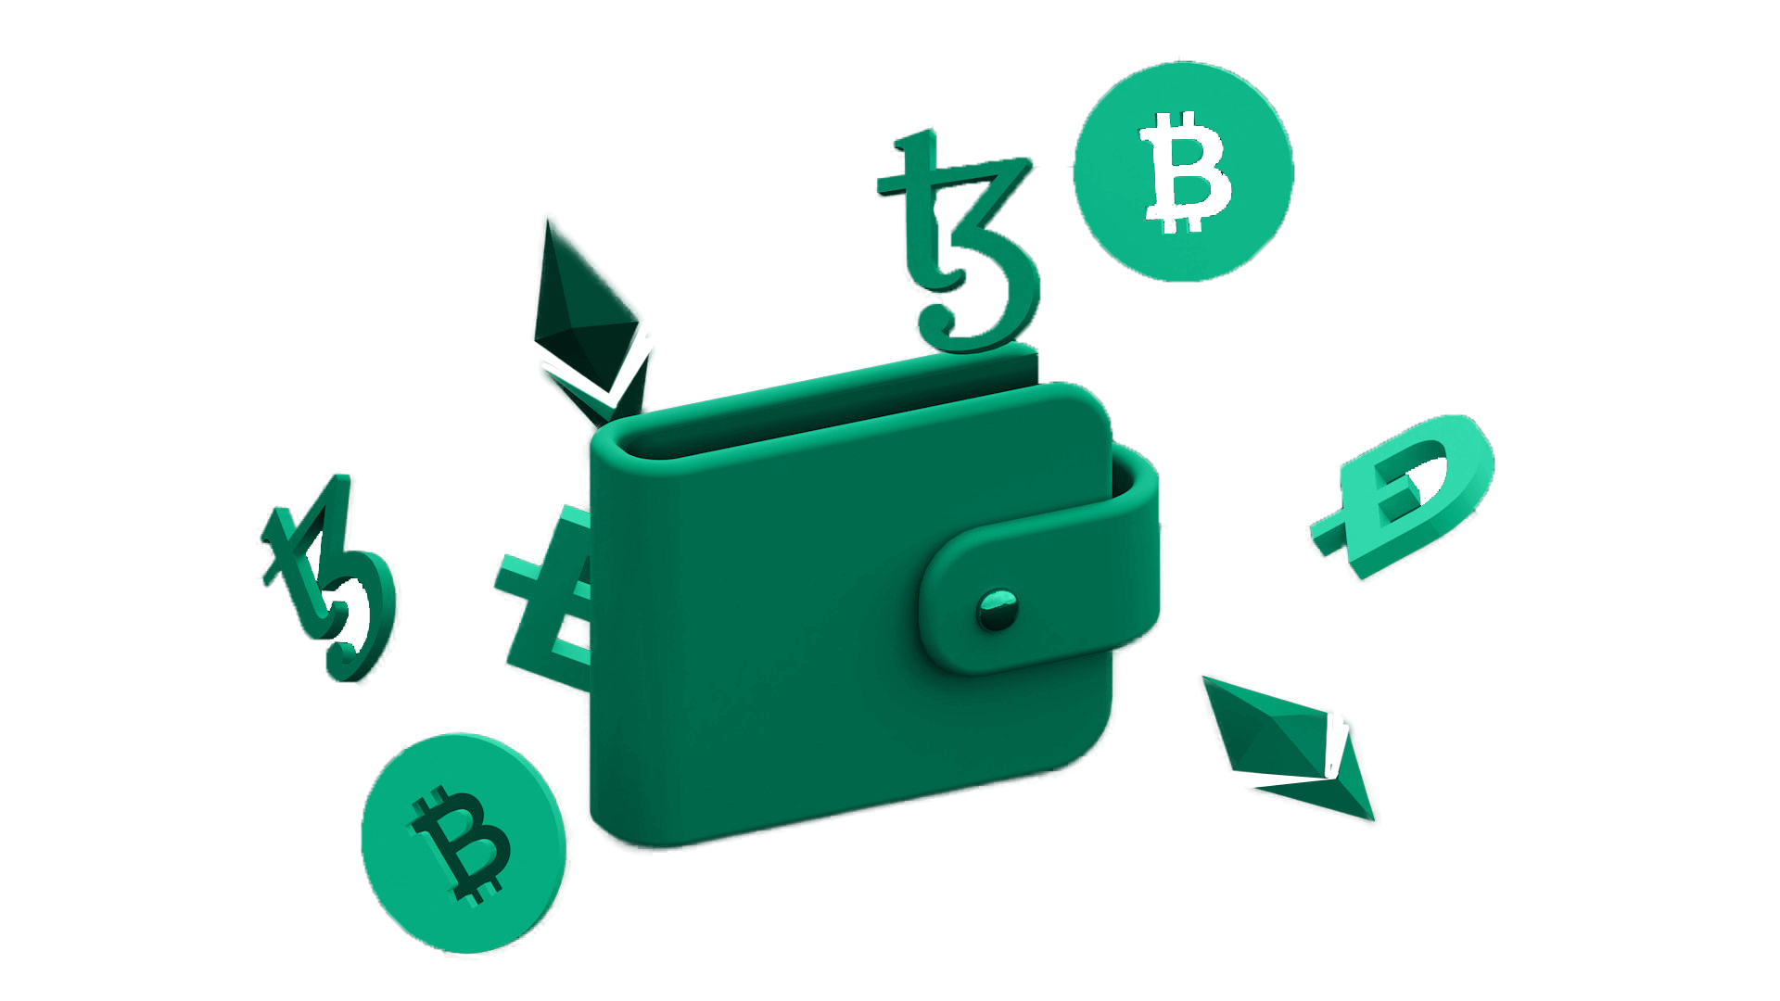
BSECA energy core application management suite
Secure Mobile Application
The application has unique cybersecurity features seamlessly provides privacy and control allowing EV owners to share only necessary information, enhancing convenience and account control
CORE STRENGTH:
Key Perk:
Pay with QAI tokens or credit/debit cards.
Simple, privacy-centered payments that make sense to everyday EV owners
Strong Privacy
Our system only takes minimal user data.
Pilot Approach
We begin with small areas. We refine as we go.
Building Networks for Sustainable EV Charging
You see what data is shared. You pick what to show

Slide 7


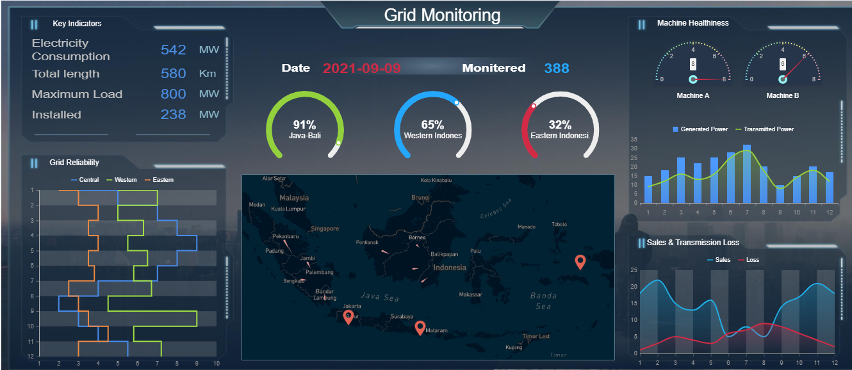



Secure Operations Management Platform
An all-encompassing security administration dashboard
Advanced Threat Detection
End-to-End Encryption
Real-Time Anomaly Detection
Multi-Factor Authentication
Secure Payment Integration
Compliance Management

Slide 8
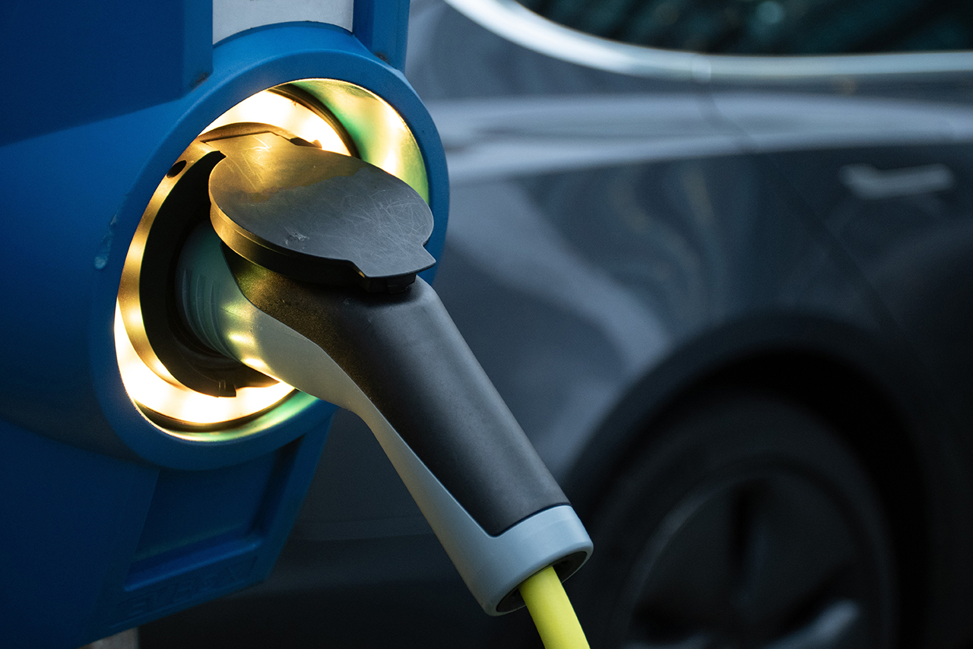


ROADMAP 2025
Q3
Q1
Foundation and Pilot
Deeper Security and Optimization
AI and Quantum Testing
Privacy Enhancements
Layer-2 Solutions
Data Insights
Infrastructure Setup
Smart Contract Basics
Small Pilot Launch
Stakeholder Onboarding
Q2
Q4
Careful Expansion
Wider Adoption
Scaling the Pilot
Energy Trading Trials
Interoperability
Community Incentives
Full-scale, Gradual Deployment
Collaborations
User Experience Boost
Network Assessment

Slide 9

2025 Outcome Goals
Global Reach
Offer QAI-charging in 15+ regions.
User Adoption
Aim for 500,000 active users
Scalability
Handle around 1 million daily transactions without lag.
Eco Efforts
Have at least 30% of stations using renewables.

Slide 10

Token Metrics

Slide 11

Our Promise
Simple, Secure EV charging for all communities
Focus on Privacy
Real-world pilot tests
Mindful tech adoption
A blend of AI and Quantum

Slide 12


Thank You
Office: Chicago, IL,US Email: info@hciss.io

